Slide 1
2019.01.23
International Mouse Phenotyping Consortium Machine Learning Hackathon
IMPCMLH
ML CHIMP

Slide 2
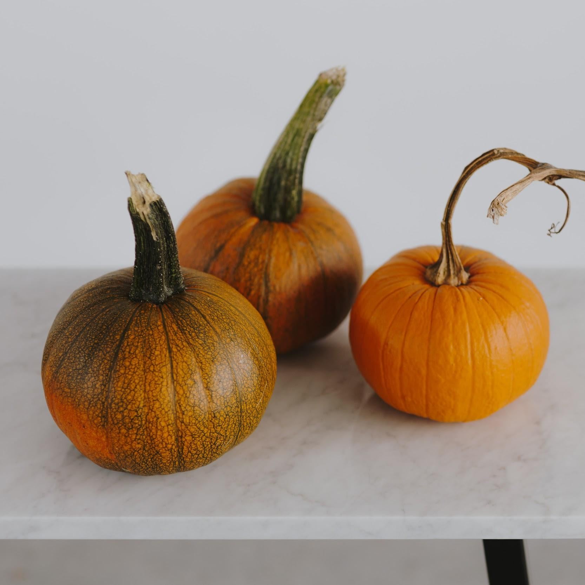
Welcome!
Let’s hack
Application of Machine Learning to IMPC data
* - three pumpkins image from kaboompics.com

Slide 3
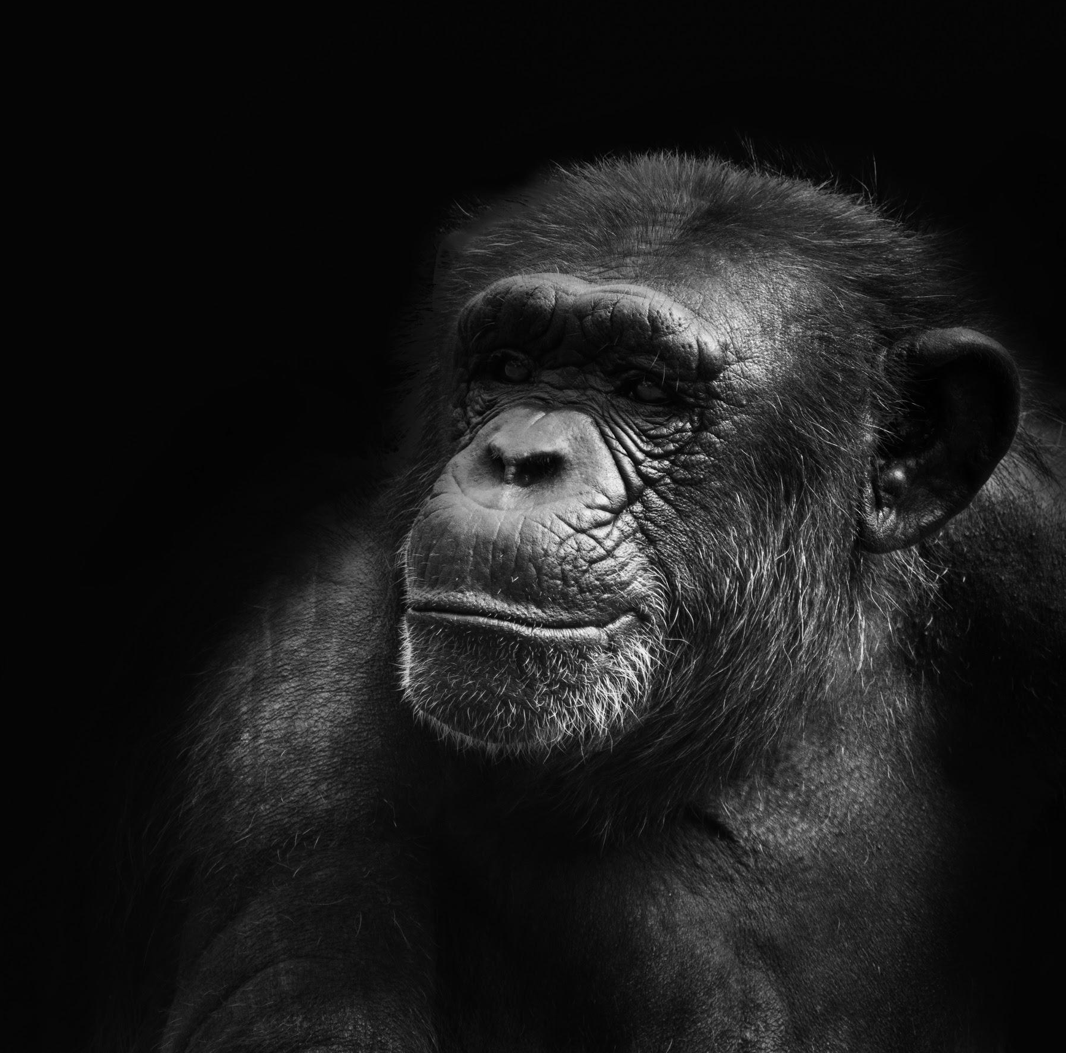
Found ML CHIMP
👍
* - Chimpanzee photo by Rishi Ragunathan on Unsplash

Slide 4
Who are we?
Starting community interested in applying machine learning to the IMPC data

Slide 5
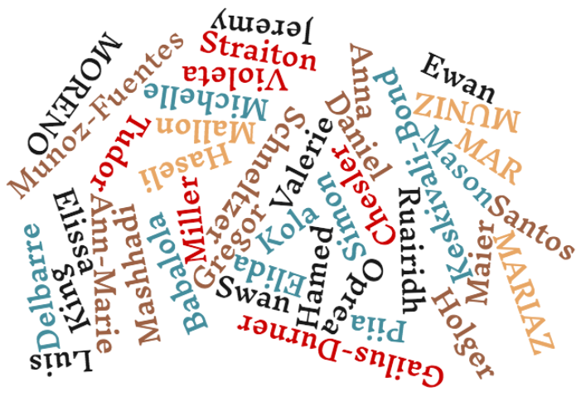
Attendees
* - wordcloud from wordclouds.com

Slide 6
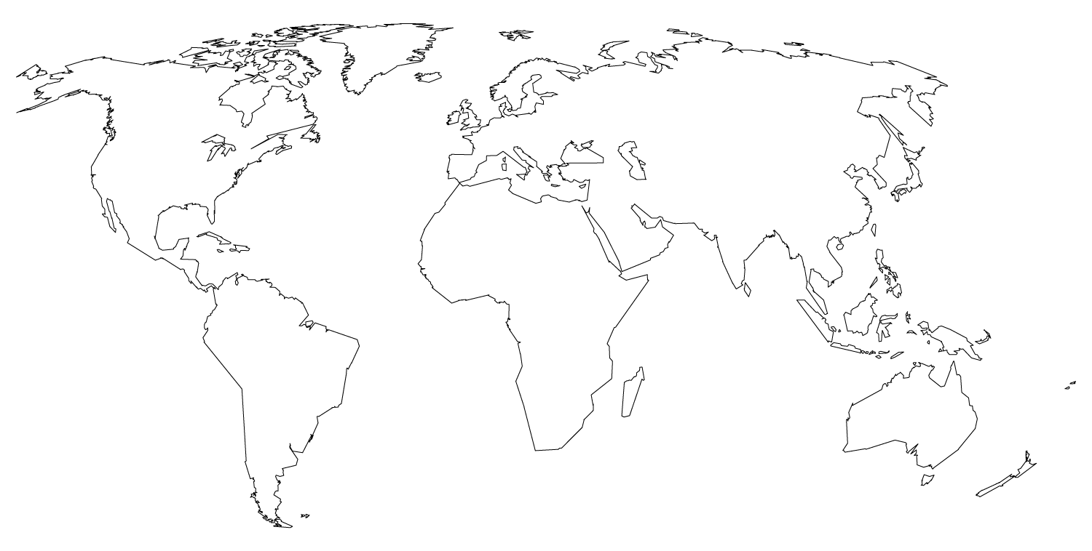
YOU ARE HERE (ish)
16,781 miles
* - distance estimates from wolfram alpha

Slide 7
What is a hackathon?
Hacking is creative problem solving.
(It does not have to involve technology.)
A hackathon is any event of any duration where people come together to solve problems.
* - helpful definitions from hackathon.guide

Slide 8
What is machine learning?
Computer systems that progressively improve their performance on a specific task.
Make predictions or decisions without being specifically programmed to perform the task.
* - other helpful definitions from wikipedia

Slide 9
Hackathon process
ML topic presentations
Break up into working groups around the proposed topics
Each WG will:
Decide question / brainstorm ML application on IMPC data
Plan for an achievable result
Discuss and distribute work
Tomorrow -- Prepare presentation of idea / work

Slide 10
Presentation time
Followed by splitting into WG

Slide 11
Thanks!
Any questions?
Jeremy Mason jmason@ebi.ac.uk
Asrar Ali Khan asrar.khan@infrafrontier.eu

Slide 12
Credits
Special thanks to all the people who made and released these awesome resources for free:
Presentation template by SlidesCarnival
Photographs by Unsplash

Slide 13
SlidesCarnival icons are editable shapes.
This means that you can:
Resize them without losing quality.
Change fill color and opacity.
Change line color, width and style.
Isn’t that nice? :)
Examples:

Slide 14
😉
Now you can use any emoji as an icon!
And of course it resizes without losing quality and you can change the color.
How? Follow Google instructions https://twitter.com/googledocs/status/730087240156643328
✋👆👉👍👤👦👧👨👩👪💃🏃💑❤😂😉😋😒😭👶😸🐟🍒🍔💣📌📖🔨🎃🎈🎨🏈🏰🌏🔌🔑 and many more...

